Slide 1
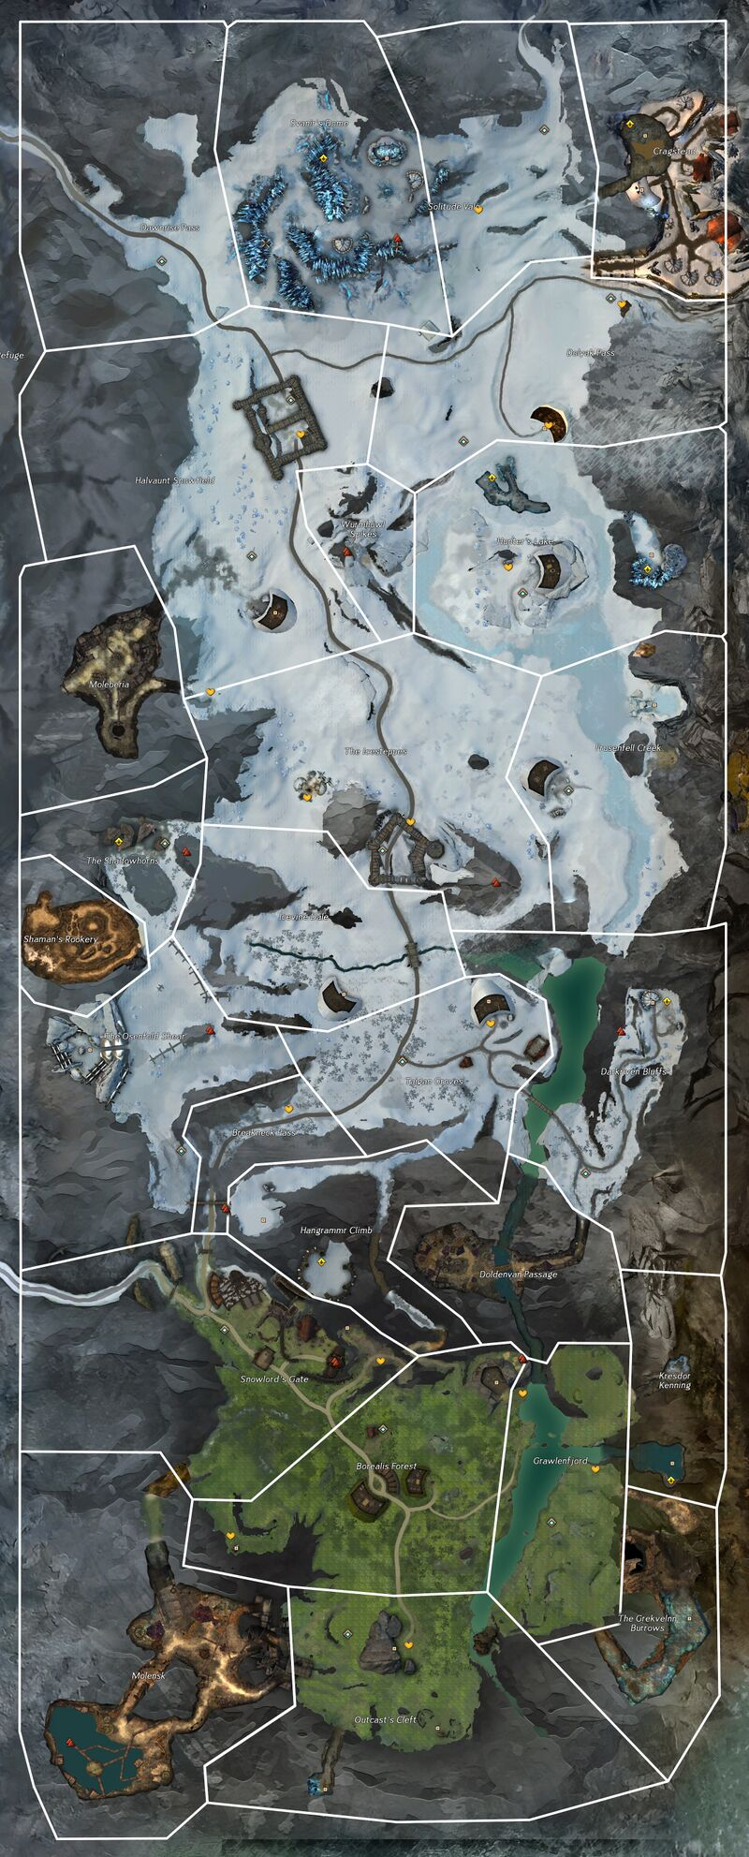
16
1-dream and wyldf hunt was disturbing, check on locals
2-pups seem to be fine, go check for with
3-undead filth, look for source of the undead
4-some of these corpses are nightmare court. There must be a hidden base nearby
5-more undead, keep checking northing
6-found a hidden entrance but cant get in. keep chjecking north
7-meet frogs, no mention of nightmare court, head west along shore to sherriff
8-talk to sheriff nora, look for a key to entrance
9-didn’t find key but found note about forces building in the bog. Head to mabon’s terrace to prep
10- Guard mentions Tovar going west to kill nightmare court
11-Tovar complains about the skritt stealing something the NC had and would like us to retrieve it
12-get through hidden door, was there anything in that chest worthwhile? I took this bloody thorn, nasty thing. Lets take it to trader’s green to report it in
13-you smell that in the air, what a putrid stench. Since we turned over the thorn, lets head north. Nothing good can come from that
14-the NC were trying to harness the power of the jungle worm?!? Outrageous. To have enough power todo that must mean their main base is around here somewhere
15-Good, we’ve found the entrance but still need to prepare a few things. While we do that, head north east and see if Zinder slope has been effected
17
15
14
13
12
11
10
9
8
7
6
5
1
2
3
4

Slide 2
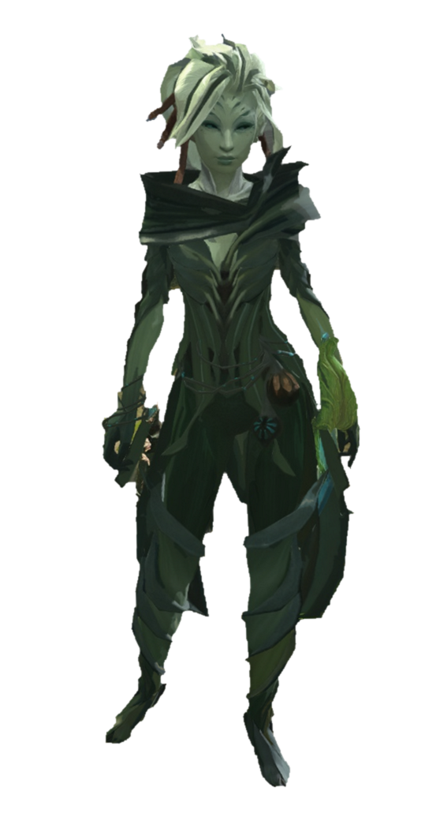


Well, if it isn’t the new “hero”. I hope that knock to your head didn’t do any permanent damage. Logan asked me to come help out but…I’ve been distracted watching that beautiful woman. She is in quite the “Diah-lema”, but I didn’t bring my working clothes. Help her out and come find me by the river.
Somehow its always bandits and this close to home. Let’s check on Flannum and make sure they haven’t done any “dam-age”. Alright, alright, I’ll stop.
You check the north side, and I’ll check the south. Meet you at the western shore.
3
2
Faren

Slide 3
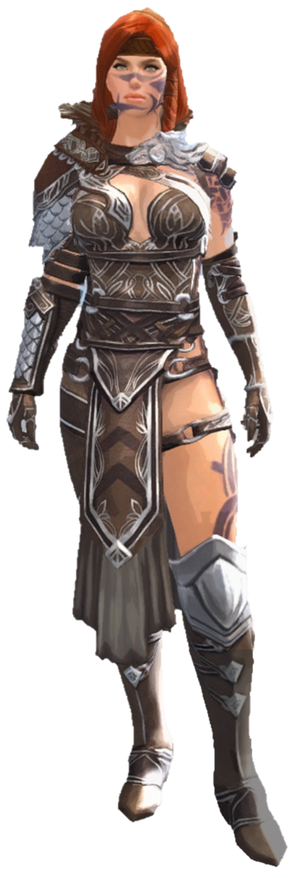

Slide 4
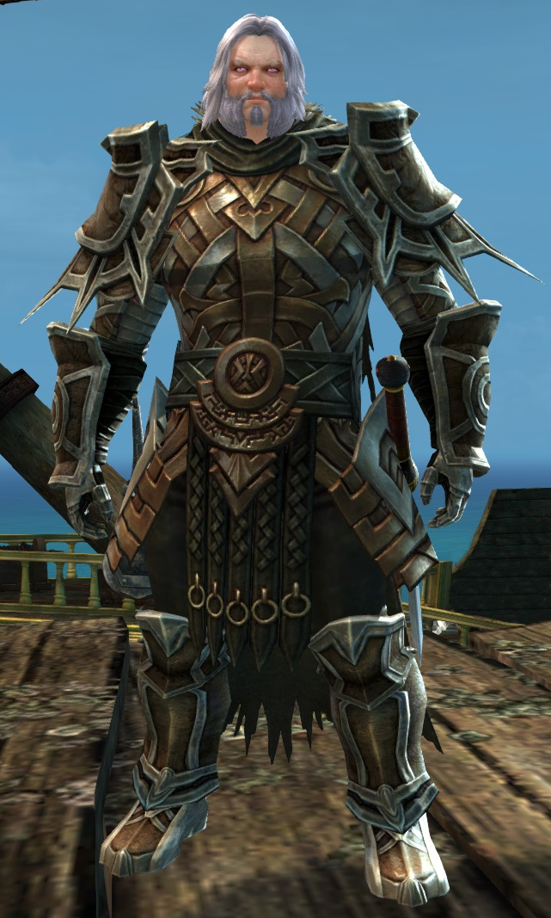
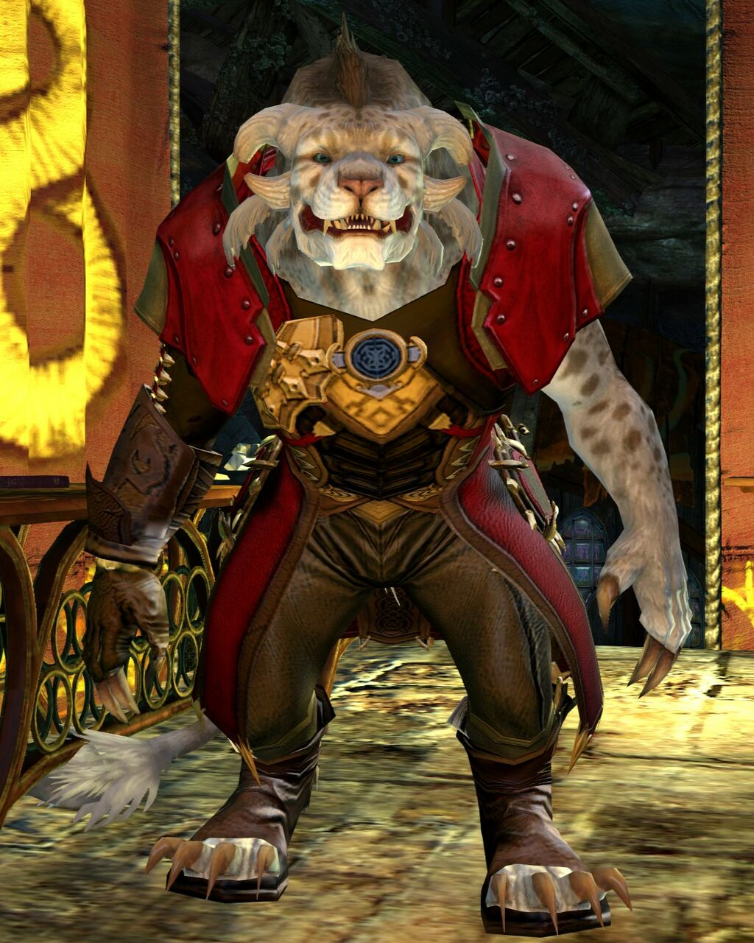
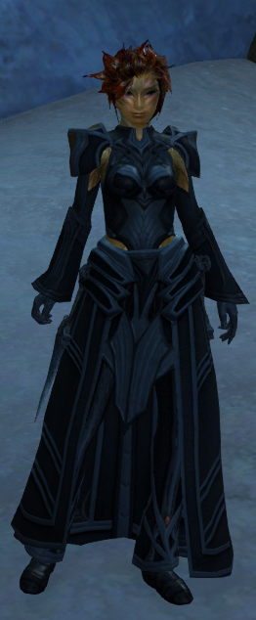

Slide 5
